Slide 1
Psychotherapy Tracker Template Version 1.0
PSYCHOTHERAPY TRACKER TEMPLATE
PURPOSE: Assist providers administering psychotherapy services. This template to be used in conjunction with [PGD Tool] and [Analytics Tool].
Tickler/Reminder: remind me on *
Tickler/Reminder Text: Prepare and Send PHQ-9 to Patient prior to next psychotherapy session.
Cascade: Index Psychotherapy F/U Activities
View Last 3 PROM Scores
Click to View Patient Education Materials
1 PRIMARY PURPOSE OF SESSION
Psychotherapy
Assessment
Case Management
Crisis Intervention/Stabilization
Other:
Notes:
Can add ‘tickler’ note to remind user to follow-up to complete something for PT (like schedule next PHQ-9).Purpose of Session -> should we ask, “Is this a psychotherapy session” with a Y/N box? If yes, present remaining options, if no pop-up stating not appropriate template. CPRS v31-B Phase 2 quick overview: https://players.brightcove.net/2851863979001/default_default/index.html?videoId=6000144812001

Slide 2
Psychotherapy Tracker Template Version 1.0
PSYCHOTHERAPY TRACKER TEMPLATE
PURPOSE: Assist providers administering psychotherapy services. This template to be used in conjunction with [PGD Tool] and [Analytics Tool].
ANALYTICS TOOL FOR PATIENT REPORTED OUTCOME MEASURES: Analytics Tool
1 PRIMARY PURPOSE OF SESSION
Psychotherapy
Assessment
Case Management
Crisis Intervention/Stabilization
Other:
Notes:
Can add ‘tickler’ note to remind user to follow-up to complete something for PT (like schedule next PHQ-9).Purpose of Session -> should we ask, “Is this a psychotherapy session” with a Y/N box? If yes, present remaining options, if no pop-up stating not appropriate template. CPRS v31-B Phase 2 quick overview: https://players.brightcove.net/2851863979001/default_default/index.html?videoId=6000144812001

Slide 3
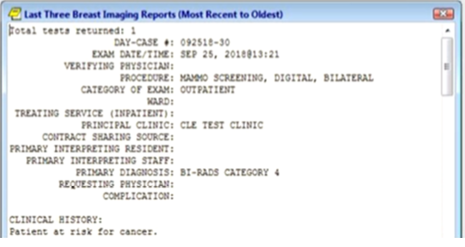
Psychotherapy Tracker Template Version 1.0
PSYCHOTHERAPY TRACKER TEMPLATE
PURPOSE: Assist providers administering psychotherapy services. This template to be used in conjunction with [PGD Tool] and [Analytics Tool].
ANALYTICS TOOL FOR PATIENT REPORTED OUTCOME MEASURES: Analytics Tool
Psychotherapy Tracker Reminder Dialog
Attention: This template is for tracking psychotherapy sessions, interventions and outcomes.
1 PRIMARY PURPOSE OF SESSION
Psychotherapy
Assessment
Case Management
Crisis Intervention/Stabilization
Other:
Notes:
Purpose of Session -> should we ask, “Is this a psychotherapy session” with a Y/N box? If yes, present remaining options, if no pop-up stating not appropriate template.

Slide 4
Psychotherapy Tracker Template Version 1.0
PSYCHOTHERAPY TRACKER TEMPLATE
PURPOSE: Assist providers administering psychotherapy services. This template to be used in conjunction with [PGD Tool] and [Analytics Tool].
ANALYTICS TOOL FOR PATIENT REPORTED OUTCOME MEASURES: Analytics Tool
1 PRIMARY PURPOSE OF SESSION
Psychotherapy
Assessment
Case Management
Crisis Intervention/Stabilization
Other:
2 TODAY’S SESSION
Initiates new episode of care
Continuing session in episode of care
Final session in episode of care
Follow-up session
Notes:
Purpose of Session -> should we ask, “Is this a psychotherapy session” with a Y/N box? If Yes, present remaining options, if no pop-up stating not appropriate template.

Slide 5
3 Focus of Current Session
Free text
4 PSYCHOTHERAPY INTERVENTION/STRATEGY
Choose all that apply:
>Depression
>PTSD
>Addiction
>Anger
Other:
Notes:
Right and down carrots indicate expanded/accordion functionality.

Slide 6
4 PSYCHOTHERAPY INTERVENTION/STRATEGY
Choose all that apply:
Depression Interventions
Acceptance and Commitment Therapy – Depression (ACT-D)
Behavioral Activation/Behavioral Therapy for Depression
Cognitive Behavioral Therapy – Depression (CBT-D)
Cognitive Behavioral Therapy – General (CBT)
Cognitive behavioral Therapy – Suicide Prevention
Interpersonal Psychotherapy – Depression (IPT-D)
Mindfulness-Based Cognitive Therapy for Depression
Problem Solving Therapy/Training (PST)
Acceptance and Commitment Therapy – Depression (ACT-D)
Behavioral Activation/Behavioral Therapy for Depression
Other:
>PTSD
>Addiction
>Anger
Other:
Notes:
User selected ‘depression’ interventions and is presented the following list. For demo purposes, we’ll assume the user selects CBT-D (hit link).

Slide 7
Depression Interventions
Cognitive Behavioral Therapy – Depression (CBT-D)
Behavioral Strategies
Activity Monitoring and/or Scheduling
Behavioral Activation/Graded Task Assignment
Guided Imagery
Breathing Exercise
Other:
Cognitive Strategies
Identified Automatic Thoughts
3 Column/ABC Thought Record
Modified Automatic Thoughts
5 Column Thought Record
Coping Cards
Problem Solving/Behavioral Experiments/Pros and Cons
Identified and/or Modified Core Beliefs
Other:
Notes:
Depression Interventions with Components options listed below.

Slide 8
End of template/footer design options?
Notes:
Depression Interventions with Components options listed below.

Slide 9
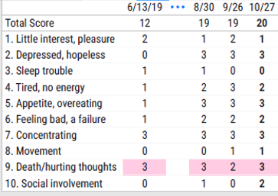
Psychotherapy Tracker Template Version 1.0
PSYCHOTHERAPY TRACKER TEMPLATE
PURPOSE: Assist providers administering psychotherapy services. This template to be used in conjunction with [PGD Tool] and [Analytics Tool].
Tickler/Reminder: remind me on *
Tickler/Reminder Text: Prepare and Send PHQ-9 to Patient prior to next psychotherapy session.
Last 3 PHQ-9 Results
Cascade: Index Psychotherapy Follow up Activities
View Last 3 PROM Scores
Click to View Patient Education Materials
1 PRIMARY PURPOSE OF SESSION
Psychotherapy
Assessment
Case Management
Crisis Intervention/Stabilization
Other:
Notes:
Can add ‘tickler’ note to remind user to follow-up to complete something for PT (like schedule next PHQ-9).Purpose of Session -> should we ask, “Is this a psychotherapy session” with a Y/N box? If yes, present remaining options, if no pop-up stating not appropriate template. CPRS v31-B Phase 2 quick overview: https://players.brightcove.net/2851863979001/default_default/index.html?videoId=6000144812001

Slide 10
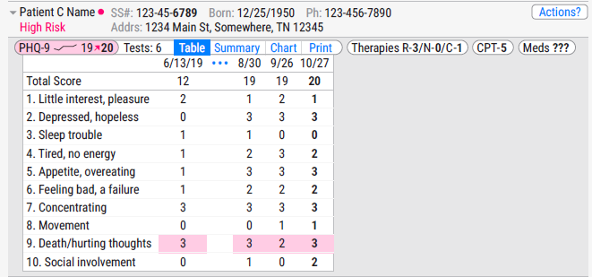
Notes:
Capsule Analytics DB view of patient here. To be updated when finalized.

